Slide 1
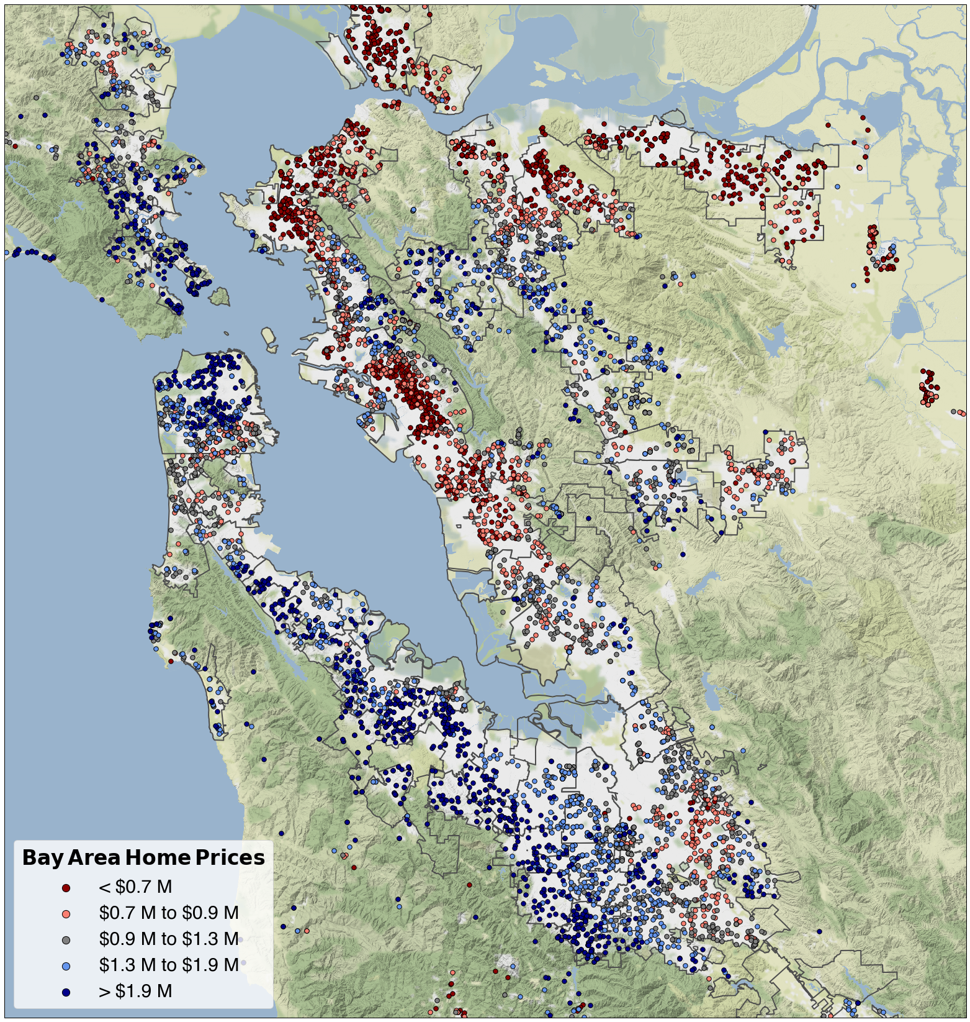
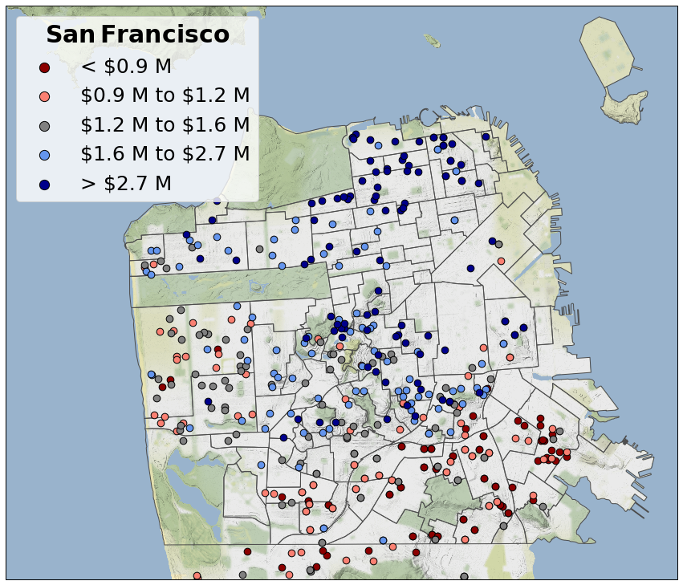
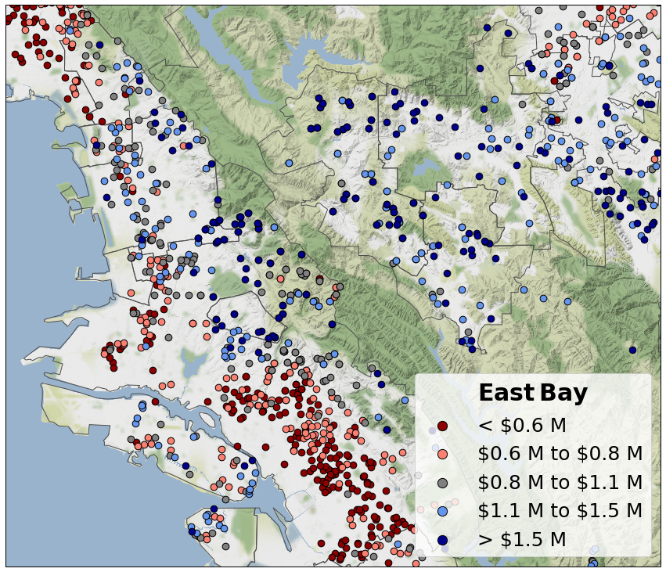
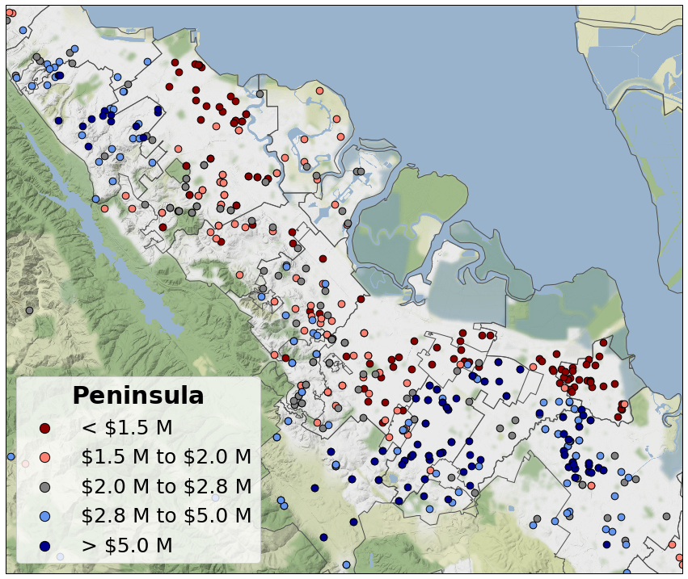
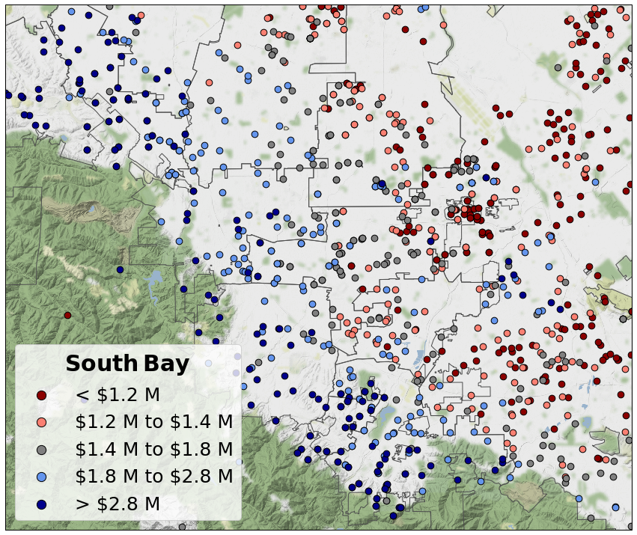
Concord
Vallejo
Novato
El Cerrito
Benicia
Richmond
Walnut Creek
San Anselmo
Marina
Russian Hill
Orinda
Lafayette
Albany
Pittsburg
Hercules
Pacific Heights
Martinez
Antioch
Berkeley
Richmond
Richmond
Soma
Alamo
Walnut Creek
Emeryville
Moraga
Ashbury Heights
Mill Valley
Tiburon
Mission
Piedmont
Berkeley
Orinda
Potrero Hill
Sausalito
Bernal Heights
Oakland
Piedmont
Sunset
Noe Valley
Danville
Miraloma Park
Oakland
Bayview
Alameda
San Ramon
San Francisco
Excelsior
Portola
Ingleside
San Leandro
Pleasanton
Daly City
Livermore
San Leandro
San Bruno
Hayward
Burlingame
Mountain View
Pacifica
Los Altos Hills
Burlingame
Los Altos
Santa Clara
San Mateo
Hillsborough
Foster City
Sunnyvale
Hillsborough
San Mateo
Fremont
Menlo Park
Redwood City
San Jose
Half Moon Bay
Cupertino
Palo Alto
Woodside
Milpitas
Belmont
Mountain View
San Carlos
Sunnyvale
Los Altos
Redwood City
Campbell
Santa Clara
Saratoga
East Palo Alto
Cupertino
San Jose
Menlo Park
Saratoga
Atherton
Palo Alto
Los Gatos
Los Gatos

Slide 2




Scrape
Requests
Beautiful soup
Clean
Re
Pandas
Analyze
Pandas
Numpy
Scikit-learn
Visualize
Cartopy
Matplotlib
Seaborn
Python 3.7, Anaconda 4.6

